Slide 1
Git

Slide 3
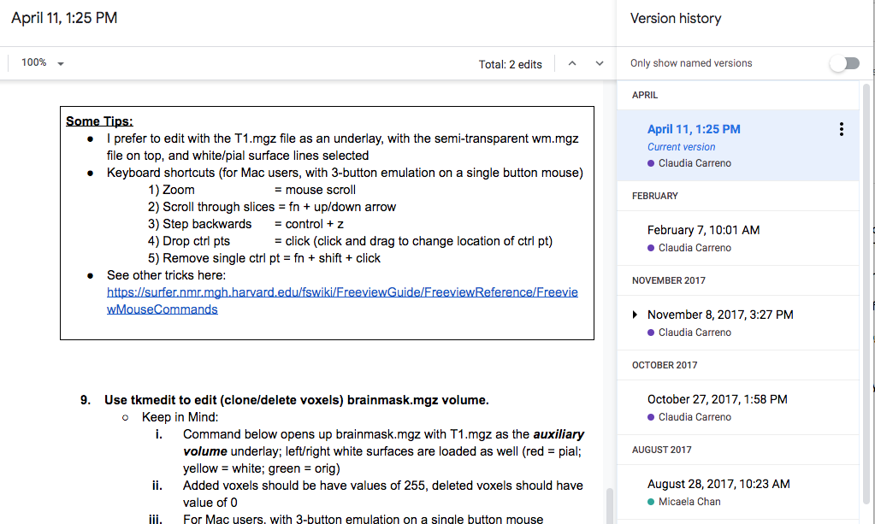
Version Control
Like track changes & version history
Microsoft Word
Changes are highlighted, and you know who did it (ideally)
Google-doc
All changes are recorded, and you can go back to see how things were like before a certain change.

Slide 4
Separate changes can be incorporated together

Slide 5
1. Setting up git
1.1 - Download git
1.2 - Configure git
Username & email
Line break
Text editor

Slide 6
2. Creating a repository > git init
2.1 – Create a directory in your Desktop
> mkdir ~/Desktop/workdir
> cd ~/Desktop/workdir
2.2 – Create a repository (stores the versions of your files)
> git init

Slide 7
3. Tracking Changes > git add, commit
3.1 – Adding new files/modification to staging area
> touch foo.txt
> git add foo.txt
3.2 – Saving these changes to the repository
> git commit –m “Add foo.txt to repo”
BONUS – Checking what has changed before add/commit
> echo hello >> foo.txt
> git diff
> git add –A
> git commit
> git log

Slide 8
File versions let us go back in time!
What is wrong with just using `my_script_version100.sh`?
Codes that worked last week don’t work anymore!?
Codes crashed after someone else changed it!?
(don’t murder them)
New lab member joins the lab, inherit a project started 4 years ago by an ex-lab-member……
Notes:
Give example from gitlab

Slide 9
4. Exploring History > git diff & show
4.1 – Difference between current file and N commit ago
> git diff HEAD
> git diff HEAD~1
> git diff efakb1
4.2 – What was done in ____ commit?
> commit show HEAD~1 foo.txt
Identifer is different for every commit/repo, use git log to check.

Slide 10
5. Reverting to a previous commit > git checkout
5.1 – Going back to a specific version of a file
> git checkout HEAD~1 foo.txt
> cat foo.txt
> git checkout HEAD foo.txt
5.2 Going back to an entire commit - Detached HEAD (CAUTION)
> git checkout HEAD~1
IF you checkout a previous commit without first committing your current state, then anything not committed would be lost!!!
> git checkout HEAD

Slide 11
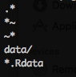
6. Telling git to ignore certain files .gitignore
Sometimes we don’t want git to track a certain type of files
Temporary files (e.g., bla.m~, .bla.txt)
Big data files (e.g., huge_matrix.mat, pca_result.Rdata)
OS files (e.g., .DS_Store)
Use a .gitignore file
> touch ignore_this.txt
> echo ignore_this.txt >> .gitignore
> git add ignore_this.txt
NOTE: .gitignore can ignore an entire subdirectory.
Here is how a typical .gitignore file might look like:
This will now tell Git to not track ignore_this.txt

Slide 12
BREAK
This ends the brief intro to version control function in git.
There is a lot more, your preferred search-engine is your friend
Next up:
Github and its cousins to help your share your codes

Slide 13
Github and other remote hosts
A remote server that hosts repositories for free
Some other choices:

Slide 14


7. Putting codes on Github make a repo
7.1 – Create a remote repository
Go to https://github.com/<username>
Click Repositories tab
Click
Enter workdir as the Repository name, click
You now have a remote repository, but its empty!
An empty repo on github would have some instructions on how to populate it

Slide 15
7. Putting codes on Github > git remote add & push
7.2 – Push an existing repository from your local computer
> cd ~/Desktop/workdir
> git remote add origin https://github.com/<username>/workdir.git
> git push –u origin master
BONUS – SSH keys can be used for authentication instead of passwords.
https://help.github.com/en/enterprise/2.15/user/articles/adding-a-new-ssh-key-to-your-github-account

Slide 16
8. Getting codes from Github > git pull

